Slide 1
Using AI in Our Work
Professional Development Session – March 18, 2025
Michael “Brody” Broshears – Director, University College

Slide 2
Introduction Questions
What excites you about AI?
What makes you nervous about AI?
How have you used AI in your work? Personal Life?
If you’ve yet to use AI tools in your work, why?

Slide 3
Goals for today’s session
Provide an overview of AI’s role in student support services like advising, financial aid, admissions, and academic support
Highlight broader trends for AI and the workplace
Understanding the functions and uses of AI tools that can be leveraged in Higher Education
See real life examples of AI in action
Begin getting hands on experience with AI-powered platforms for communication predictive analytics, and student engagement

Slide 4
AI in the Workplace
November 2022, Open AI launched ChatGPT
Some stats:
Industries
Only a third (33%) of all US employees say their organization has begun integrating AI into their business practices
White collar industries that number rises to 44%
Employees
Two thirds of employees say they have never used AI in their role (54% of white collar)
Only one in 10 say they are using AI at least weekly (15% of white collar)
These figures remained essentially unchanged from 2023 to 2024
WHAT will move the needle here?
Gallup. (2024, October 8). AI in the workplace: Answering 3 big questions. Gallup. https://www.gallup.com/workplace/651203/workplace-answering-big-questions.aspx

Slide 5
Improving AI Adoption
Few employees feel prepared to use AI in their roles
Only 6% of employees feel very comfortable using AI in their roles
16% of employees say they are very or somewhat comfortable using AI
32% said they were very uncomfortable using AI in their roles
From 2023 to 2024 the number of employees who said they are very prepared to work with AI dropped by six percentage points
Gallup. (2024, October 8). AI in the workplace: Answering 3 big questions. Gallup. https://www.gallup.com/workplace/651203/workplace-answering-big-questions.aspx

Slide 6
Gallup. (2024, October 8). AI in the workplace: Answering 3 big questions. Gallup. https://www.gallup.com/workplace/651203/workplace-answering-big-questions.aspx

Slide 7
Employees that use AI find it helpful Gallup. (2024, October 8). AI in the workplace: Answering 3 big questions. Gallup. https://www.gallup.com/workplace/651203/workplace-answering-big-questions.aspx

Slide 8
Three key strategies for improving AI Adoption
Clearly communicated plan for integration
Clearly established guidance for AI use
Training aligned with employees’ roles
Notes:
Clearly Communicated Plan for Integration
As mentioned above, while 93% of CHROs say they have begun using AI in their organizations, only 33% of employees have heard about it. And only 15% of employees say their organization has communicated a clear plan or strategy for integrating AI technology into current business practices.
However, when employees strongly agree that there is a clear plan, they are 2.9 times as likely to feel very prepared to work with AI and 4.7 times as likely to feel comfortable using AI in their role.
In other words, only a small part of the workforce is self-motivated early adopters. Most employees won’t feel comfortable with AI until leadership communicates a plan.
Clearly Established Guidance for AI Use
Seventy percent of employees say their organization does not have guidance or policies for using AI at work. While this percentage is lower (60%) for white-collar industries and employees who currently use AI at least once a year (47%), it still means a majority of employees in the most AI-affected jobs do not have straightforward guidelines about using AI at work.
This lack of guidance limits employee use of AI technology and creates security risks. By establishing clear guidelines for usage, organizations can empower their workforce to use these technologies effectively and securely, ensuring AI serves as a tool for furthering innovation and efficiency rather than a liability.
Training Aligned with Employees’ Roles
Similarly, almost half of workers who use AI at least once a year say their organizations have not offered any sort of training on using AI at work. When employees participate in required training, they are 89% more likely than those who have not received any training -- formal or informal -- to say that AI will have an extremely positive impact on their individual productivity and efficiency at work.
While experimentation may be part of getting comfortable with AI tools, formal educational experiences are crucial to motivating employees to explore AI tools and use them effectively on their own.

Slide 9
Improving AI Adoption, continued
Understand the source of the confidence gap
Start small and stay focused
Decide how you want to deploy AI in your work – and practice
Reeves, E., & Chase, A. (2025, February 4). Three ways to help faculty feel more confident about AI. Inside Higher Ed. https://www.insidehighered.com/opinion/career-advice/teaching/2025/02/04/three-ways-help-faculty-feel-more-confident-about-ai
Notes:
Do they have challenges to overcome due to prior exposure to AI or other technology? Do they have the foundation to understand how AI works and how to be successful with this technology? Have they seen how generative AI is or could change your role? And have you considered that improving their own knowledge and awareness can enhance their work and better prepare their students for success at the institution?

Slide 10
Leaders need to lead by example
In March 13, 2025, Inside Higher Ed article, Northern Arizona president highlighted how he came to use AI in academic leadership:
Drafting responses to routine emails
Analyzes past student performance data and created quizzes designed to assess specific learning outcomes
Brainstormed ways to present complex concepts linking course material to Gen Z cultural touch points
Speechwriting
Team management (conflicting viewpoints upload to get to shared values)
Personal usage
Cruz Rivera, J. L. (2025, March 13). A president’s journey to AI adoption. Inside Higher Ed. Retrieved from https://www.insidehighered.com/opinion/career-advice/advancing-administrator/2025/03/13/presidents-journey-ai-adoption-opinion[1](https://www.insidehighered.com/opinion/career-advice/advancing-administrator/2025/03/13/presidents-journey-ai-adoption-opinion)

Slide 11
The Challenges for Advising
59% of students use AI tools at least once a month, showing promise as a catalyst to address advisor capacity challenges
AI tool usage amongst frontline support providers is lagging, with 49% of academic advisors and counselors having never used these tools
Only 11% of administrators and advisors say their student success data is ready to seed generative AI models. Though generative AI can supplement limited advisor capacity, most institutions are unprepared to leverage it for student success, despite some targeted implementations
https://tytonpartners.com/driving-toward-a-degree-2024/

Slide 12
The Challenges for Advising
Implementing generative AI for academic planning “can potentially save advising meeting time spent on the technical aspects of course registration, enabling more holistic advising conversations.”
Tyton’s survey also found, among advisers, helping students select courses or a plan of study was the top daily activity, with 95 percent of academic advisers and 59 percent of faculty advisers selecting this option.
BUT,
Over half of first-year students believe they could select the right courses each term, and 60 percent of students beyond their first year agree with this, as well.
https://tytonpartners.com/driving-toward-a-degree-2024/

Slide 13
AI Use and Academic Advising
EAB Article
Research done by Sam Rittenberg
Wanted to learn:
What activities take up most of an advisor’s time when meeting with students
Are advisors spending time on activities they think are most impactful?
Would advisors redistribute their time to have a greater impact if they could?

Slide 14
Results…
Advisors wanted to spend >50% less time on transactional activities like…
Course Selection and Schedule Creation
Advisors would like to redistribute that time on longer-term strategic activities like…
Goal Setting & Planning, Academic Coaching, Personal Coaching
Rittenberg, Sam. “Advisors Want to Spend 50% Less Time on These Activities.” EAB, 12 Apr. 2018, www.eab.com/blogs/student-success-insights/2018/04/advisors-want-to-spend-less-time-on-these-activities

Slide 15
And, the research supports this idea… for advisors
Advising, at its core, is about supporting and facilitating the career and academic development of the students we serve.
Appreciative Inquiry, Developmental Advising, Advocacy Advising, Advising as Teaching all operate with the STUDENT at the center (interactive process, relationship driven, with both the advisor and student benefitting from the process)
Concept of congruence, positive regard, and empathy
Hughey, Judy K. “Strategies to Enhance Interpersonal Relations in Academic Advising.” NACADA Journal, vol. 31, no. 2, 2011, pp. 22–32., doi:10.12930/0271-9517-31.2.22.

Slide 16
Tools supported by ISU Key Takeaways:
ChatGPT is best for text-based tasks (summaries, responses, content creation)
Microsoft Co-Pilot excels in workflow automation and productivity (emails, reports, scheduling)
Adobe Firefly is ideal for visual content creation (flyers, graphics, social media visuals)
Zoom AI enhances meeting efficiency with automated transcription and note-taking

Slide 17
Tool | Primary Function | Best Uses in Higher Ed | Key Features | Integration
ChatGPT (OpenAI) | Conversational AI, Text Generation | Advising emails, student FAQs, policy summaries, content creation | Strong natural language processing (NLP), coding capabilities, text-based assistance | Standalone app, integrates with Microsoft via Azure
Microsoft Co-Pilot | Productivity AI for MS Office | Meeting summaries, document drafting, email automation, data insights | Embedded in Microsoft 365 (Word, Excel, Teams, Outlook), AI-powered writing and analysis | Fully integrated into Microsoft ecosystem
Adobe Firefly | AI for Image & Content Creation | Creating visuals for advising, marketing, recruitment materials | AI-generated images, text-to-image capabilities, graphic design automation | Works within Adobe Creative Cloud (Photoshop, Illustrator)
Zoom AI | Meeting Summarization & Productivity | Transcribing advising sessions, summarizing student meetings, auto-generating follow-ups | AI-powered transcription, action item tracking, automated note-taking | Integrated into Zoom meetings

Slide 18
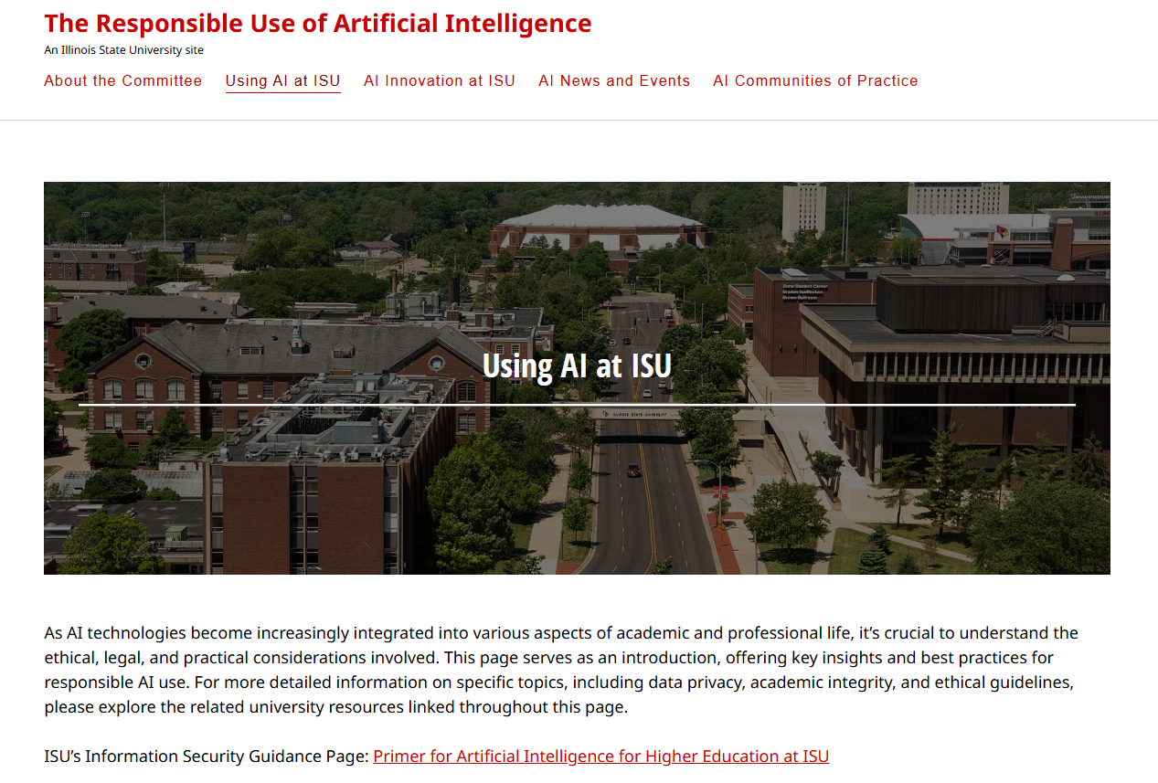
Responsible Use of AI Link https://about.illinoisstate.edu/ai/using-ai-at-isu/

Slide 19
Examples of Brody Use
Elementary Education Four-Year Plan
Thrive Feedback Summary
Email to student in academic difficulty
Advising/Registration Schedule
Opening a record store

Slide 20
Your Prompts

Slide 21
Questions, thoughts, suggestions…
Michael “Brody” Broshears
Director, University College
Illinois State University
mabros1@ilstu.edu

