Slide 1
Focus on a Wellness Mindset The Power of Mindfulness
Jim Almeda, M.S., CHES
Coordinator, Assessment & Well-being Initiatives
Certified Koru Mindfulness Teacher
Certified Health and Wellness Coach
Illinois State University, Health Promotion and Wellness

Slide 2
Opening Meditation
https://www.youtube.com/watch?v=2OEL4P1Rz04

Slide 3
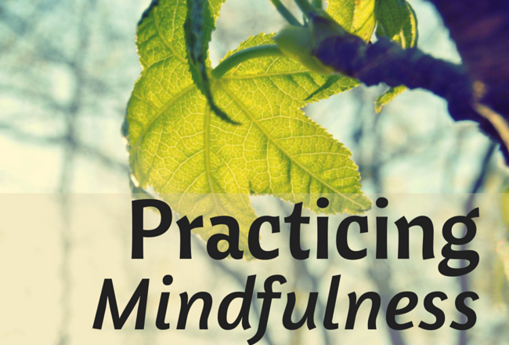
Goals for the Presentation
Participants will be able to:
Describe what mindfulness is and how it impacts our wellness mindset.
Identify how mindfulness can enhance our well-being.
Identify the barriers to practicing mindfulness and strategies to overcome them.
Practice mindfulness in our everyday lives.
Locate resources that support a mindfulness practice.

Slide 4
Let’s Hear from You First
What challenges are you currently facing?
How is this impacting your ability to practice self-care?
What do you hope to get out of this session?

Slide 5
Why do we need mindfulness?
Stress
Anxiety
Sleep problems
Feel overwhelmed
Loneliness
COVID-19
Work
Relationships
Finances
Technology/Social Media

Slide 6
To take care of your students, family, etc. you need to take care of you first!

Slide 7
What is Mindfulness?

Slide 8
So, what is mediation then?

Slide 9
Mindfulness Includes Compassion
Compassion & kindness for self and others
Recognizing that others have difficulties in life
Allowing and accepting things to be as they are in this present moment
Peace of mind is the highest form of happiness

Slide 10
Compliment More, Criticize Less
5:1 Ratio

Slide 11
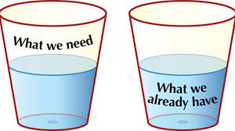
Happiness and Acceptance
Genetic temperament – 50%
Circumstances of our lives – 10%
Intentional behaviors – 40%
How we relate to our circumstances
Gratitude

Slide 12
Questions to Ask Yourself in Stressful Situations
Is it a big deal?
If no, let it go (acceptance)
If yes, proceed
Can I change the situation?
If not, let it go (acceptance) & manage emotions and feelings
If yes, choose the best course or action (mindfully)

Slide 13
Koru Mindfulness
Meet once a week (4 weeks)
Meditation (5 – 10 minutes/day)
Mindfulness practice
Gratitude's (daily)
Logs and check-in
Improves sleep, eating behaviors, focus and academic (and athletic) performance, reduces stress and anxiety, and contributes to a greater sense of well-being and happiness.

Slide 14
Barriers to Practicing Mindfulness
Time
Patience
Having a quiet place
Self-efficacy
Doubt or skepticism

Slide 15
Mindfulness

Slide 16
Are you skeptical?
Does this really work?
Where is the science behind this?
Let’s take a look:
Mindfulness meditation and the brain:
https://www.youtube.com/watch?v=5AqgMo1P05E

Slide 17
The Impact of Mindfulness
Mindfulness meditation doesn’t change life. Life remains as fragile and unpredictable as ever. Meditation changes the heart’s capacity to accept life as it is. Sylvia Boors The Mindful Twenty-Something

Slide 18
Eye of the Hurricane
Mindfulness

Slide 19
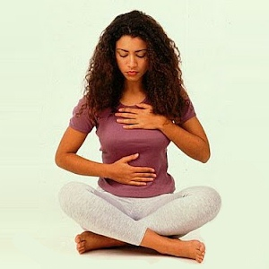
Let’s Practice . . . Belly Breathing The Power of the Breath
https://www.youtube.com/watch?app=desktop&v=2OEL4P1Rz04

Slide 20
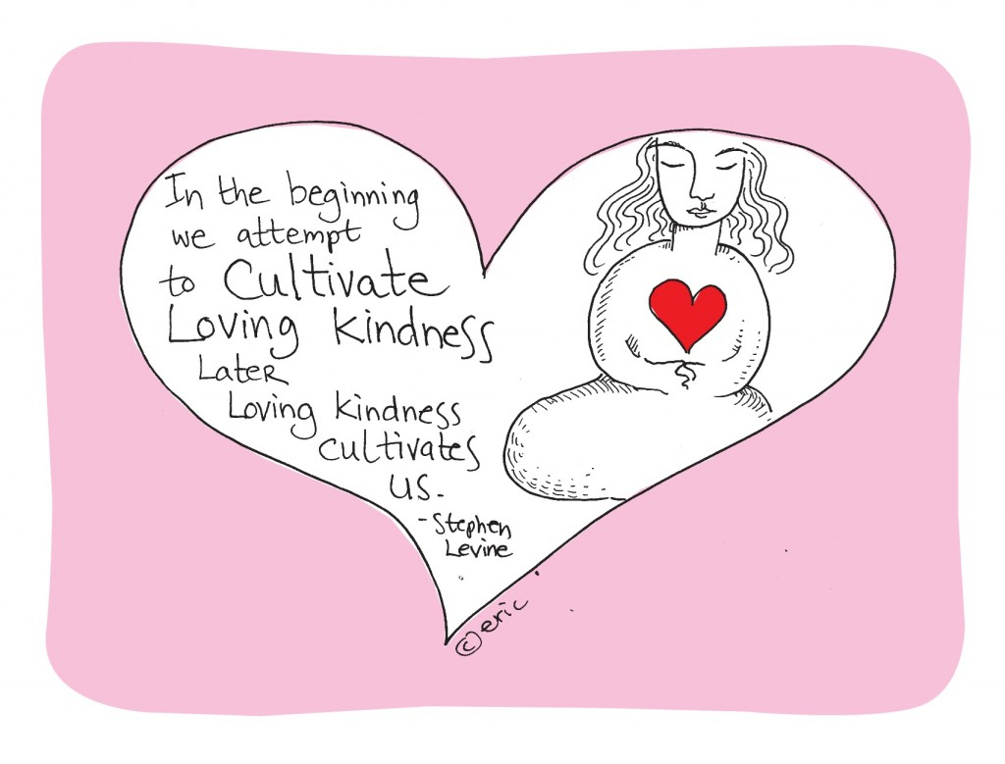
Loving Kindness
May I be happy
May I be healthy
May I be peaceful
May I be safe
May you be happy
May you be healthy
May you be peaceful
May you be safe

Slide 21
Dynamic Breathing

Slide 22
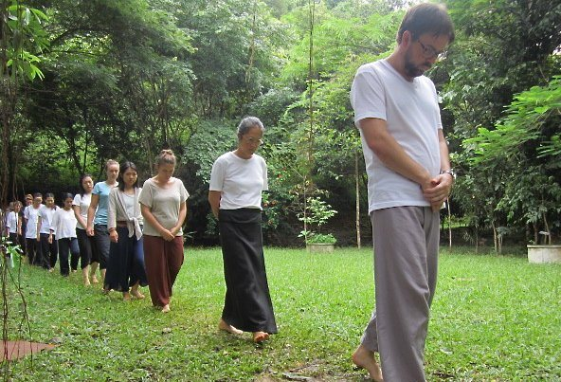
Other Koru Meditation Practices
Walking meditation
Gatha
Body Scan
Guided Imagery
Labeling Thoughts
Labeling Feelings
Chair Yoga

Slide 23
Books on Mindfulness

Slide 24
Online Resources
http://korumindfulness.org/
www.wellness.ilstu.edu

Slide 25
Jon Kabat-Zinn
“You can’t stop the waves,
But you can learn to surf.” Wherever You Go, There You Are: Mindfulness Meditation in Everyday Life

Slide 26
Contact Information
Jim Almeda
jralmed@ilstu.edu
(309) 438-2053
www.wellness.illinoisstate.edu

